Slide 1
Graphs
Algorithm Design and Analysis
Bibliography:
[CLRS]- Subchap 22.1 – Representation of Graphs

Slide 2
Graphs (part1)
Basic concepts
Graph representation

Slide 3
Graphs
A graph G = (V, E)
  V = set of vertices
  E = set of edges = subset of V × V
  |E| <= |V|²

Slide 4
Directed/undirected graphs
In an undirected graph:
  Edge (u,v) ∈ E implies that also edge (v,u) ∈ E
  Example: road networks between cities
In a directed graph:
  Edge (u,v) ∈ E does not imply edge (v,u) ∈ E
  Example: street networks in downtown

Slide 5
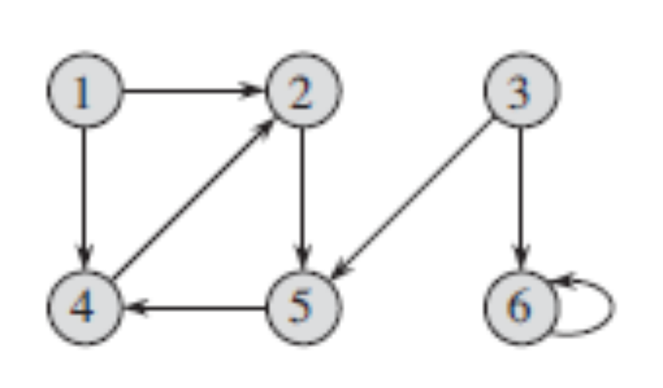

Directed/undirected graphs
Directed graph
Undirected graph
[CLRS] Fig 22.1, 22.2
Self-loop edges are possible only in directed graphs

Slide 6
Degree of a vertex
In-degree=2
Out-degre=1
degree=3
Degree of a vertex v:
  The number of edges adjacenct to v
  For directed graphs: in-degree and out-degree

Slide 7
Weighted/unweighted graphs
In a weighted graph, each edge has an associated weight (numerical value)

Slide 8
Connected/disconnected graphs
An undirected graph is a connected graph if there is a path between any two vertices
A directed graph is strongly connected if there is a directed path between any two vertices

Slide 9
Dense/sparse graphs
Graphs are dense when the number of edges is close to the maximum possible, |V|²
Graphs are sparse when the number of edges is small (no clear threshold)
If you know you are dealing with dense or sparse graphs, different data structures are recommended for representing graphs
  Adjacency matrix
  Adjacency list

Slide 10
Representing Graphs –
Adjacency Matrix
Assume vertexes are numbered V = {1, 2, …, n}
An adjacency matrix represents the graph as a n x n matrix A:
  A[i, j] = 1 if edge (i, j) ∈ E
  = 0 if edge (i, j) ∉ E
For weighted graph
  A[i, j] = w_{ij} if edge (i, j) ∈ E
  = 0 if edge (i, j) ∉ E
For undirected graph
  Matrix is symmetric: A[i, j] = A[j, i]

Slide 11
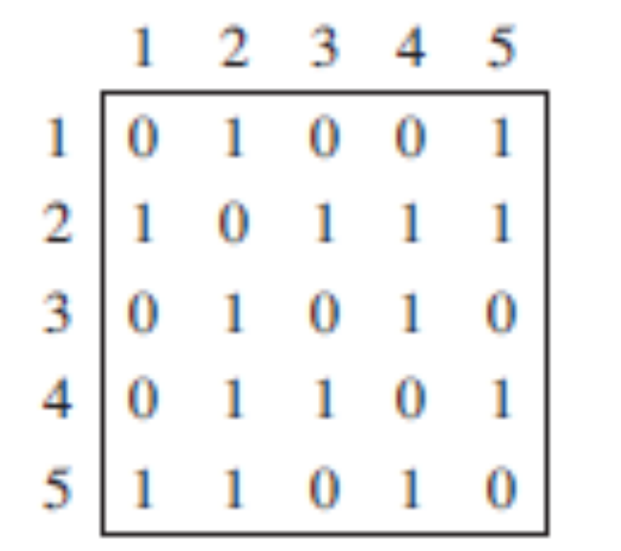
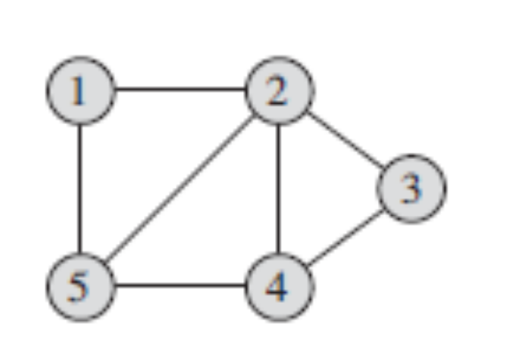
Graphs: Adjacency Matrix
Example – Undirected graph:
[CLRS] Fig 22.1

Slide 12
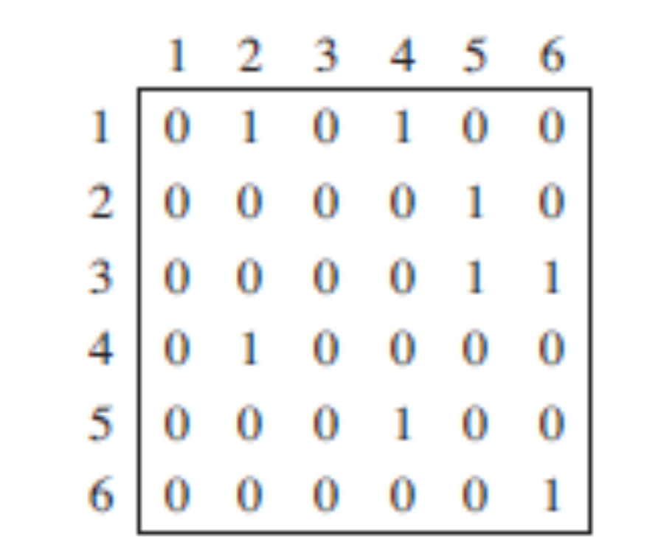
Graphs: Adjacency Matrix
Example – Directed Unweighted Graph:
[CLRS] Fig 22.2

Slide 13
Graphs: Adjacency Matrix
Time to answer if there is an edge between vertex u and v: Θ(1)
Memory required: Θ(n²) regardless of |E|
  Usually too much storage for large graphs
  But can be very efficient for small graphs

Slide 14
Graphs: Adjacency List
Adjacency list: for each vertex v ∈ V, store a list of vertices adjacent to v
Weighted graph: for each vertex u ∈ adj[v], store also weight(v,u)

Slide 15
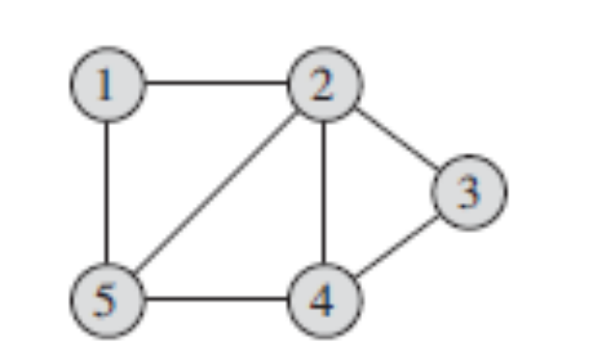
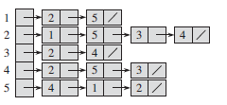
Graph representations: Adjacency List
Undirected unweighted graph
[CLRS] Fig 22.1

Slide 16
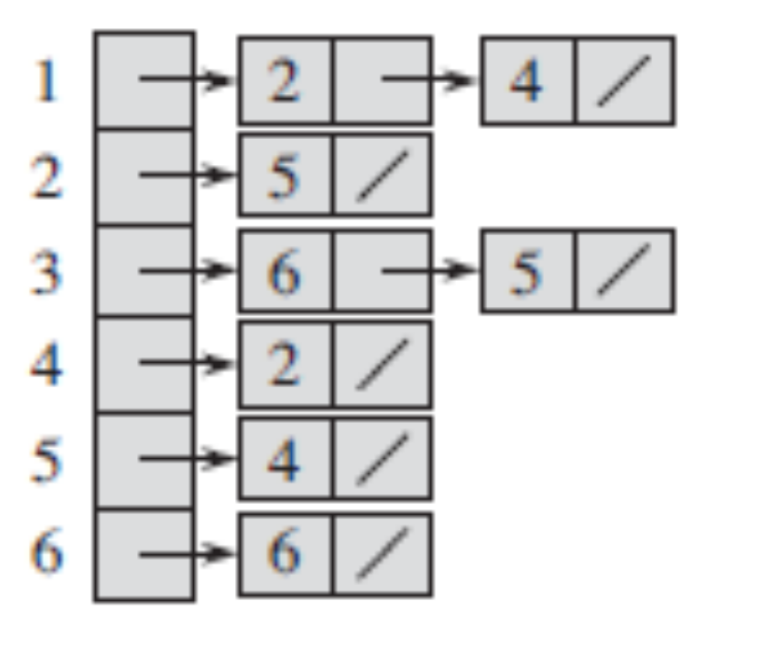

Graph representations: Adjacency List
Directed unweighted graph
[CLRS] Fig 22.2

Slide 17
Graphs: Adjacency List
How much memory is required?
For directed graphs
  |adj[v]| = out-degree(v)
  Total number of items in adjacency lists is
  Σ out-degree(v) = |E|
For undirected graphs
  |adj[v]| = degree(v)
  Number of items in adjacency lists is
  Σ degree(v) = 2 |E|
Adjacency lists needs Θ(V+E) memory space
Time needed to test if edge (u, v) ∈ E is O(E)

Slide 18
Graph Implementation - Lab
http://staff.cs.upt.ro/~ioana/algo/2019/lab_mst.html
You are given an implementation of a SimpleGraph ADT:
  ISimpleGraph.java defines the interface of the SimpleGraph ADT
  DirectedGraph.java is an implementation of the SimpleGraph as a directed graph. The implementation uses adjacency structures.
  UndirectedGraph.java is an implementation of SimpleGraph as a undirected graph. The implementation extends class DirectedGraph described before, by overriding two methods: addEdge and allEdges.

